Slide 1
Registers

Slide 2
Registers
Flip-flop is one bit memory cell
To store n bits-n flip-flops are needed
Group of flip-flops which can store a binary data-Registers

Slide 3
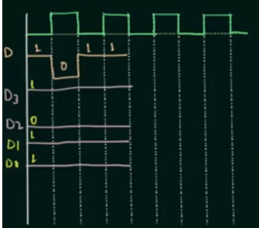
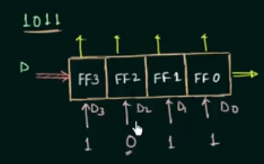
Data formats
One bit at a time
All data bits simultaneously

Slide 4
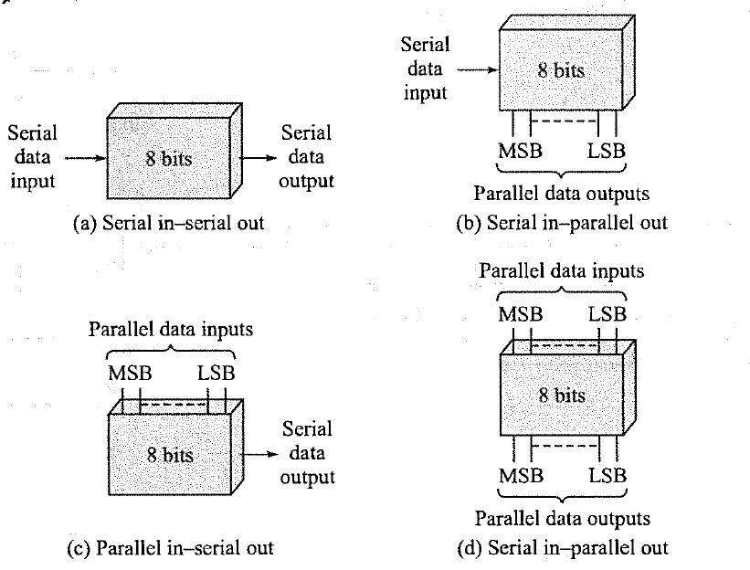
Classification of registers

Slide 5
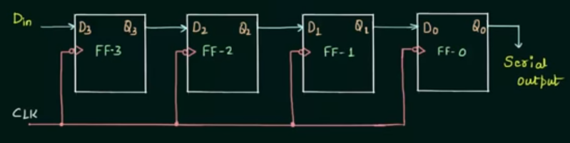
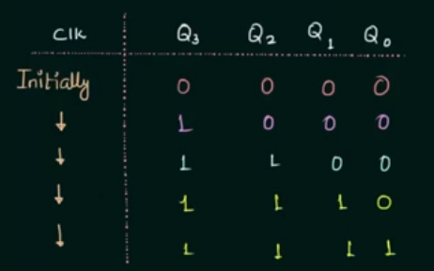
Serial in Serial out
Shifting
Storage

Slide 6
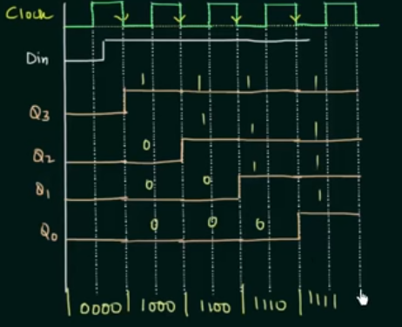
Serial in Serial out
To store 4 bit data you need 4 cycles
To fetch the data you need 4 cycles

Slide 7
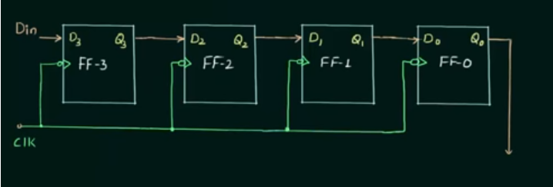
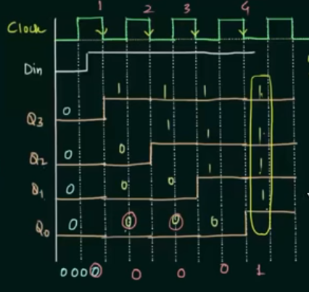
Serial in Parallel out
To store 4 bit data you need 4 clock Pulse but fetch the data you need 1 pulse

Slide 8
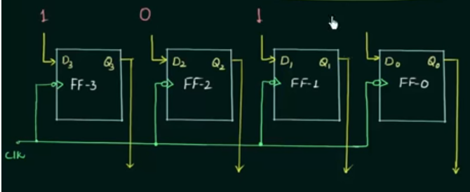
Parallel in parallel out
Storage register and buffer register
To store 4 bit data you need 1 cycles
To fetch the data you need 1 cycles

Slide 9
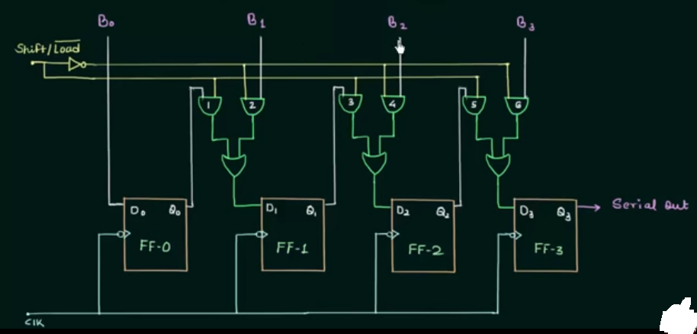
Parallel in serial out

Slide 10
Modes of operation of PISO
Two modes
Load mode(Load’ =0)
Shift mode(shift=1)

Slide 11
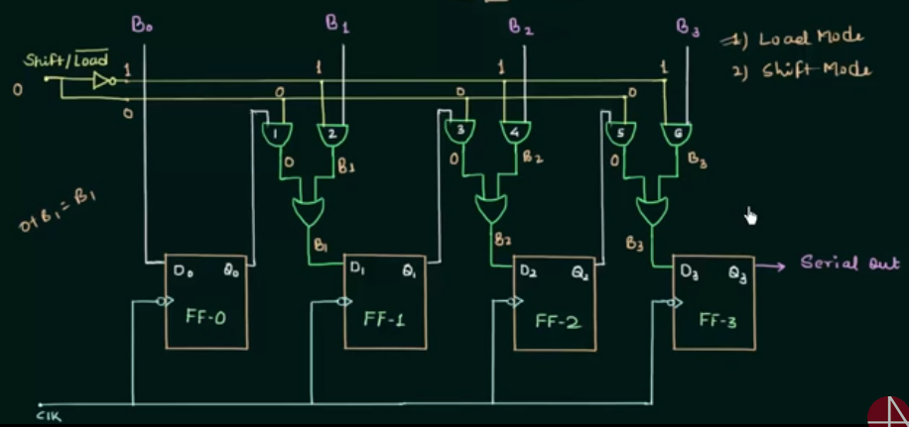
Load Mode

Slide 12
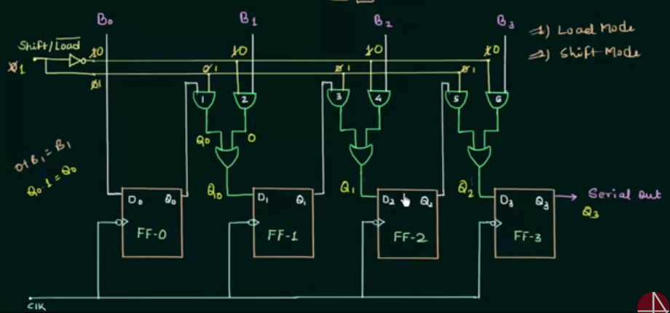
Shift mode

Slide 13
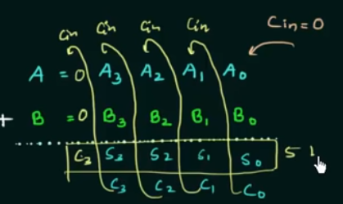
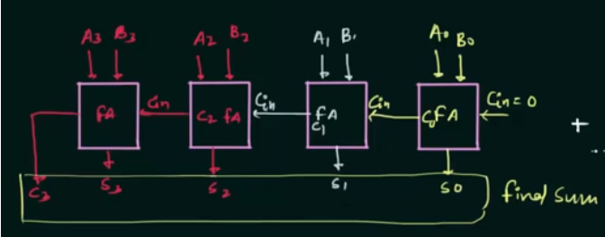
Parallel Adder

Slide 14
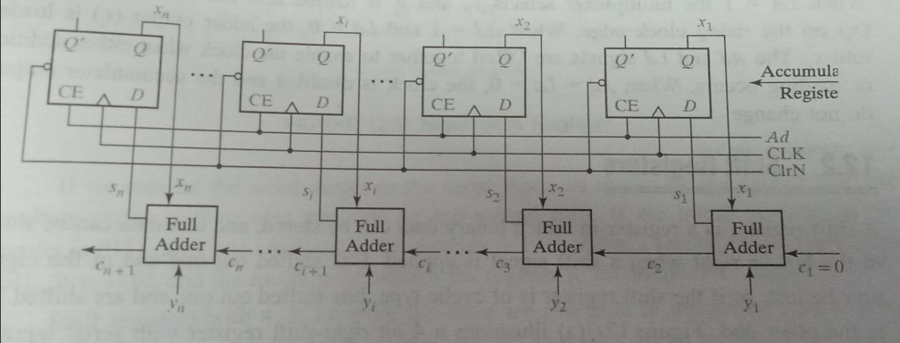
Parallel Adder with Accumulators

Slide 15
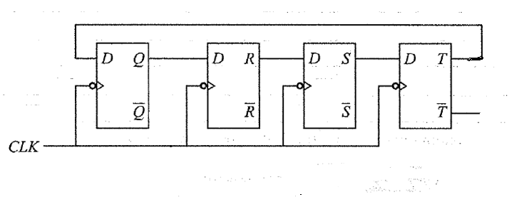
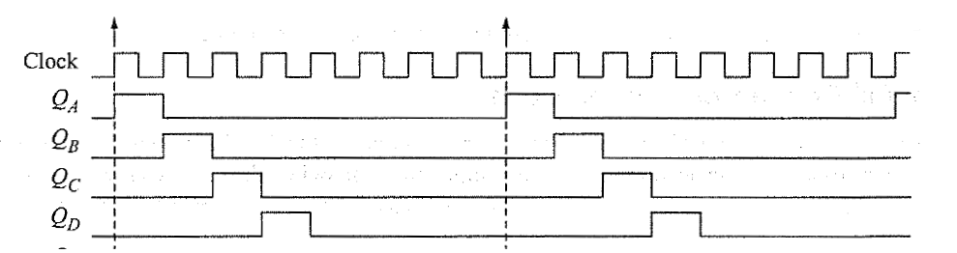
Application of shift Register Ring Counter

Slide 16
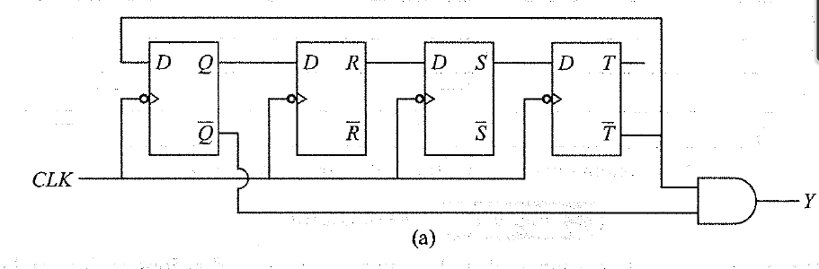
Johnson ring counter

Slide 17
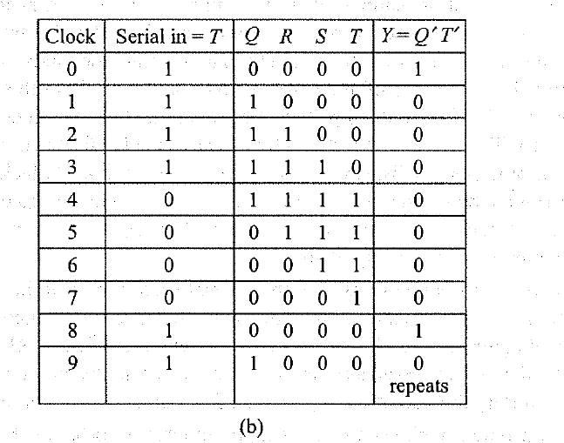

Slide 18
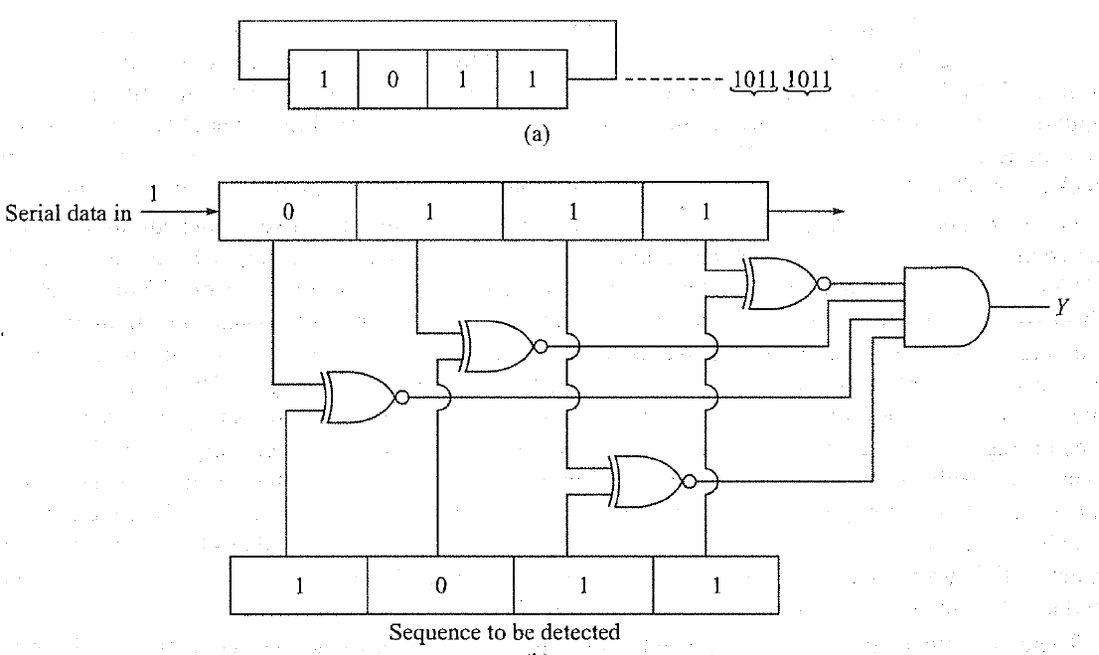
Sequence Generator and Sequence detector

Slide 19
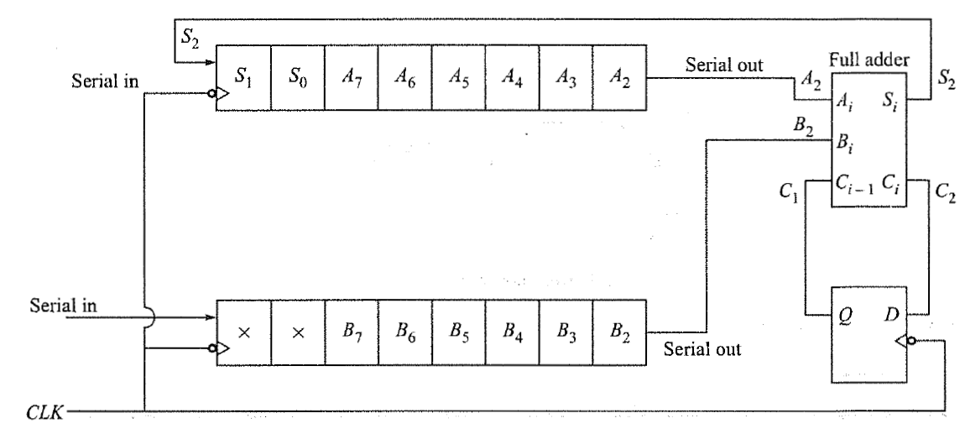
Serial adder

Slide 20
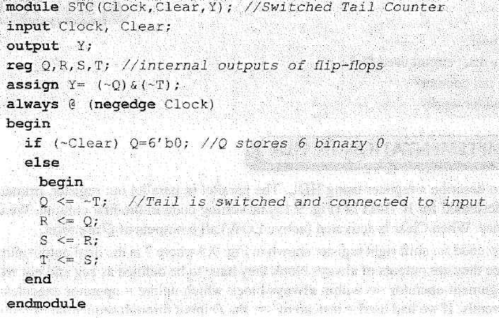
Verilog code for switch tail counter

Slide 21
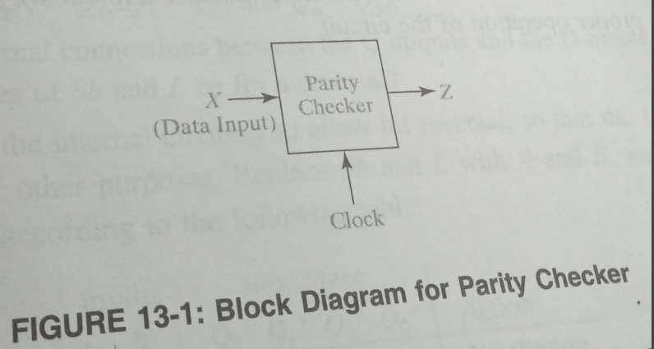
A sequential Parity Checker

Slide 22
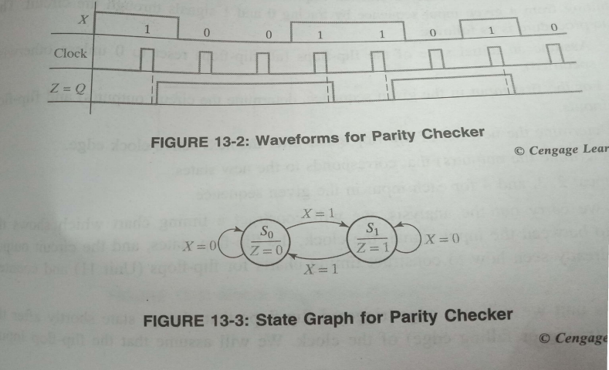
A sequential Parity Checker

Slide 23
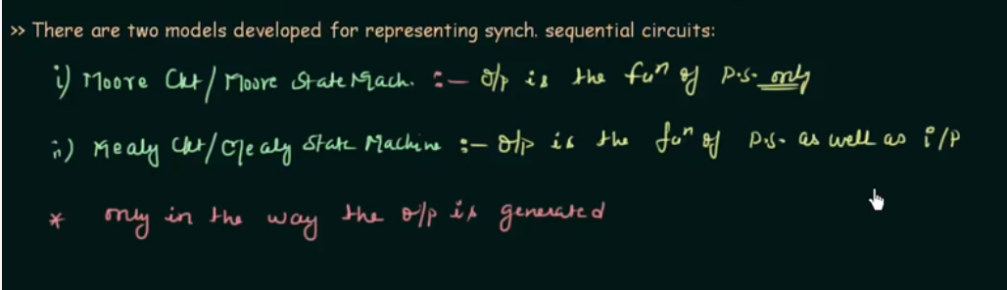

Slide 24
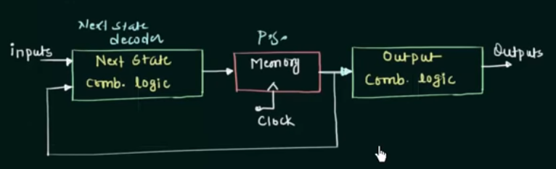
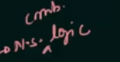
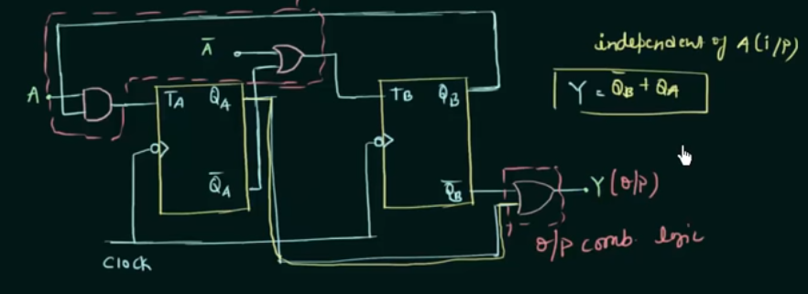

Slide 25
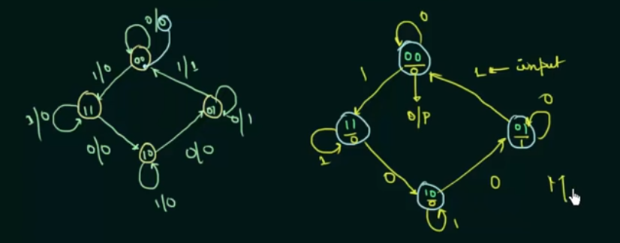
Moore State Diagram

Slide 26
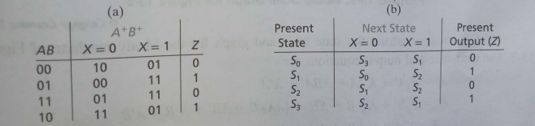
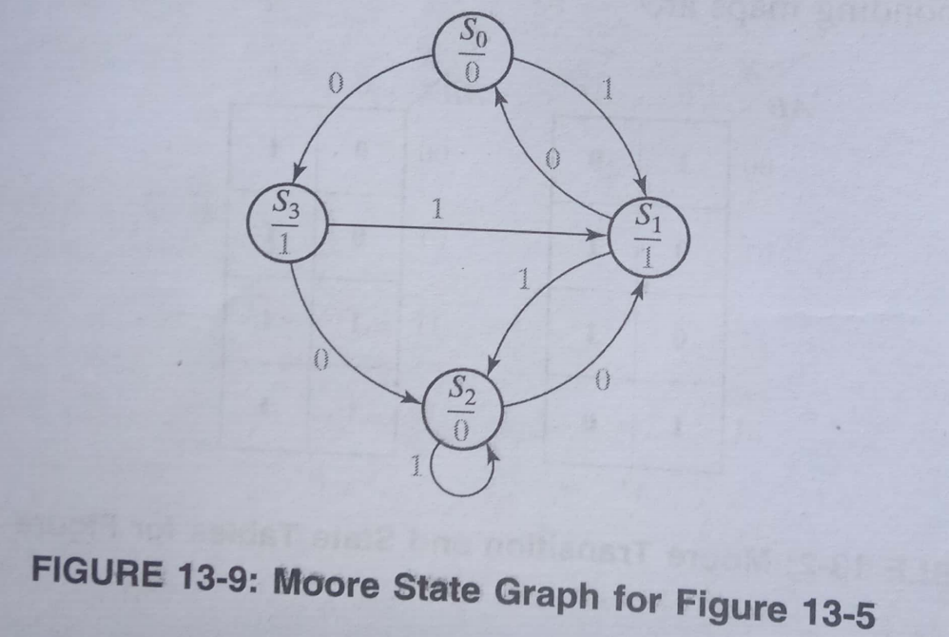

Slide 27
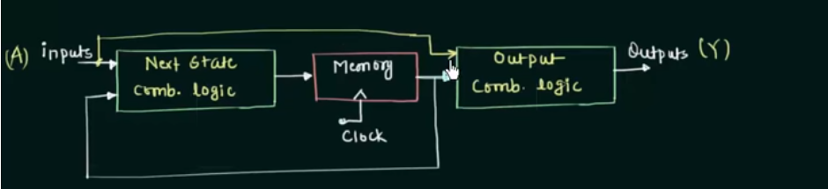
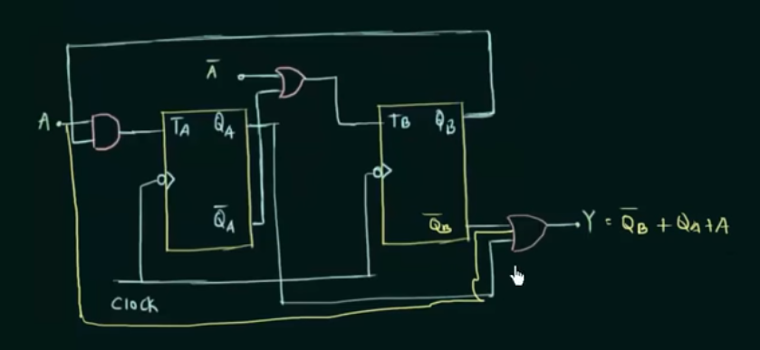

Slide 28
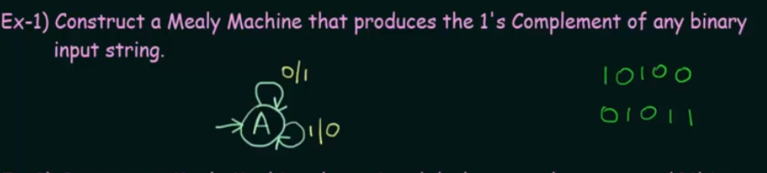

Slide 29
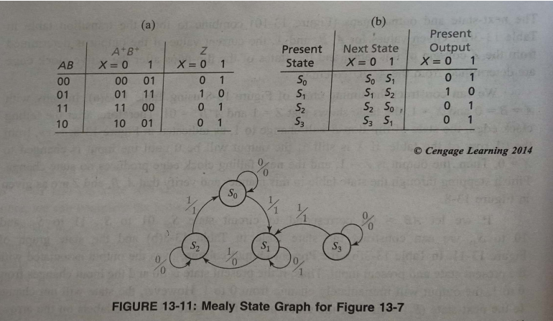

Slide 30
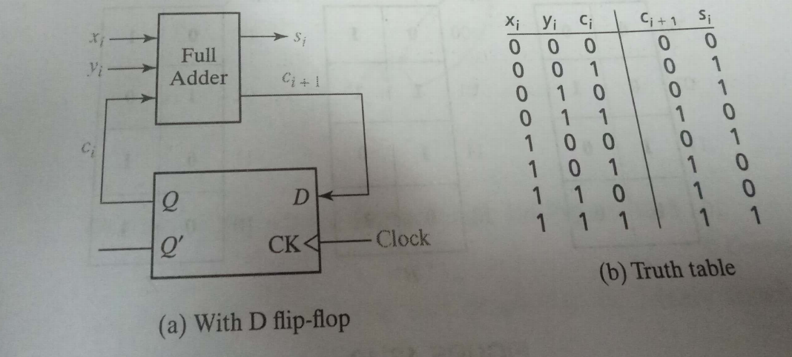
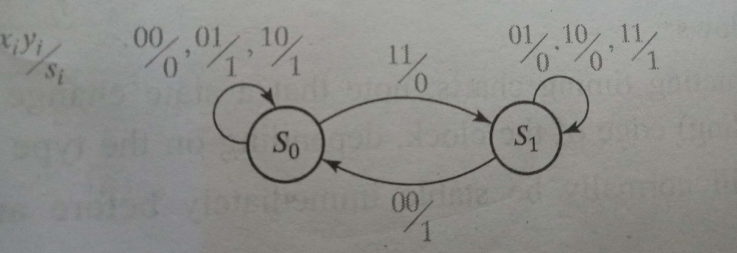
State graph for Serial Adder

Slide 31
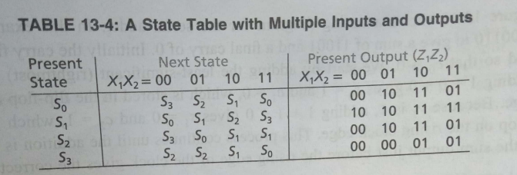
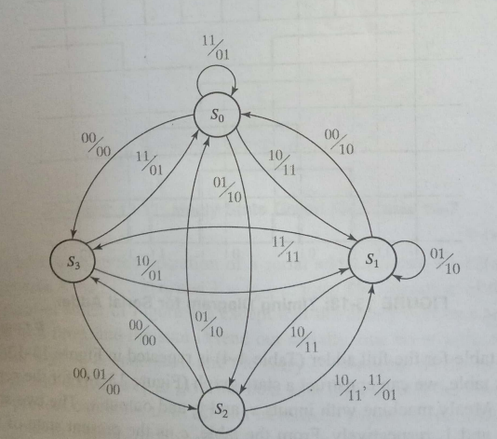

Slide 32
Counters
Counter driven by clock counts number of clock cycles
Two types of counters
Asynchronous counters
synchronous counters

Slide 33
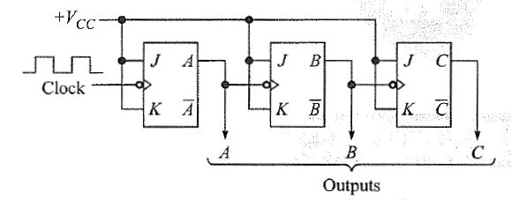
Asynchronous counters
Asynchronous UP counters

Slide 34
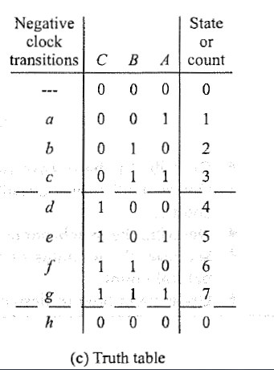
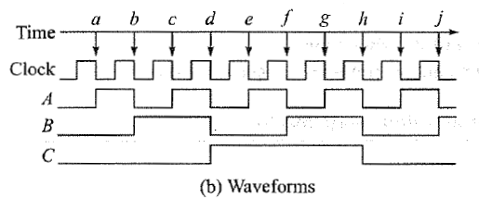

Slide 35
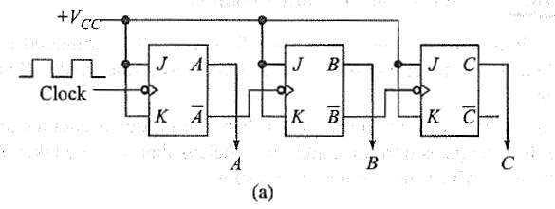
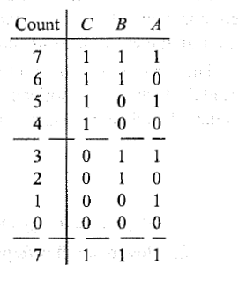
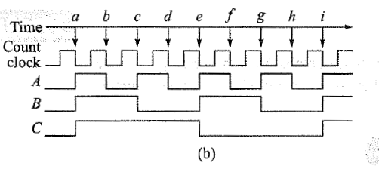
Asynchronous Down counters

Slide 36
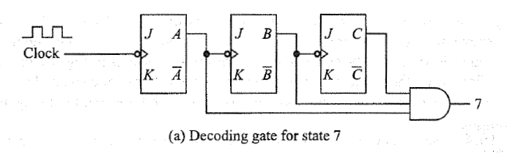
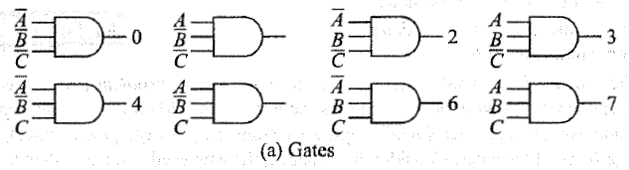
Decoding Gates
connected to counters –output will be high only when counter content is equal to the given state

Slide 37
